Slide 1


RETRIEVAL OF LOST MOBILE PHONES

Slide 2

PROBLEM STATEMENT
In the current times whenever a phone get lost there are few approach to track the phone and locate it.
But it requires to meet certain
conditions like phone should be
switched ON or internet connectivity
should be present.
If phone is switched OFF it’s very
difficult to track the phone.

Slide 3


Google Find my device
IMEI Number
Tracking apps like Cerberus,Prey Anti-theft etc
Drop box
Google photos location information
Google Timeline
ceir.gov.in
CURRENT
TECHNOLOGY

Slide 4

CHALLENGES
Mobile Switched Off
No Network connection
Changing IMEI number
Removing SIM Card
Airplane Mode On

Slide 5
AZURE SERVICES USED
Azure app services https://azure.microsoft.com/en-in/services/app-service/
Azure maps https://azure.microsoft.com/en-us/services/azure-maps/ (for location tracking)
Application Gateway https://azure.microsoft.com/en-in/services/application-gateway/ (for security)

Slide 6
SOLUTION
Creating an Internal GPS Tracker circuit.
It consists of backup power for this circuit alone and a sim card in it.
When phone gets switched off , it automatically gets on.
Thus a signal will be sent from phone to the nearest tower that helps us to locate the phone.

Slide 7
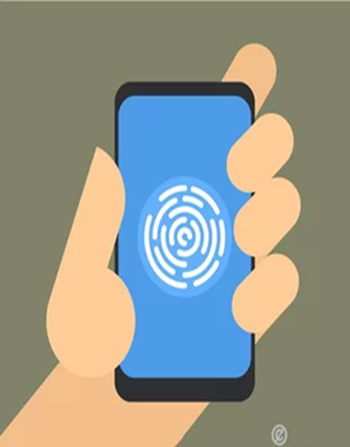

SOFTWARE IMPLEMENTATIONS
In case if we can’t track by hardware components ,we can track our mobile phones also by software implementations.
Whenever the phone is logged again ,the sim inside the GPS tracker will send a command to the Operating system ,which is already programmed with specific codes to enables the camera automatically and it starts recording .It helps for tracking of the device
It will be saved as default settings in all phones and cannot be changed.

Slide 8

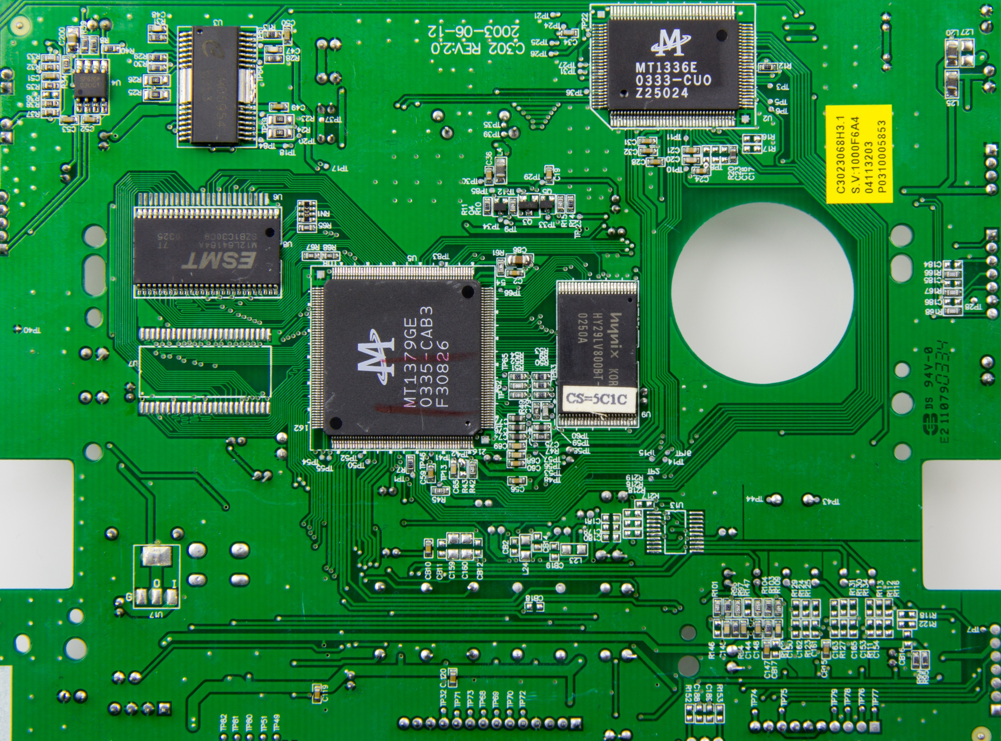
MOBILE TURNED ON
CIRCUIT TURNED OFF

Slide 9

MOBILE TURNED OFF
CIRCUIT TURNED ON

Slide 10


INBUILT BATTERY DIED
BACKUP BATTERY TURNED ON

Slide 11


ADVANTAGES
We can take photos of hackers and intruders.
We can
track
phone for
ourselves
We can
locate phone
from anywhere.
It is simple and effective

Slide 12
REFERENCES
https://www.hellolori.com/post/five-easy-ways-to-track-your-lost-android-phone
https://www.cashify.in/how-to-track-your-lost-mobile-phone-with-imei-number

Slide 13
THANK YOU

